Slide 1
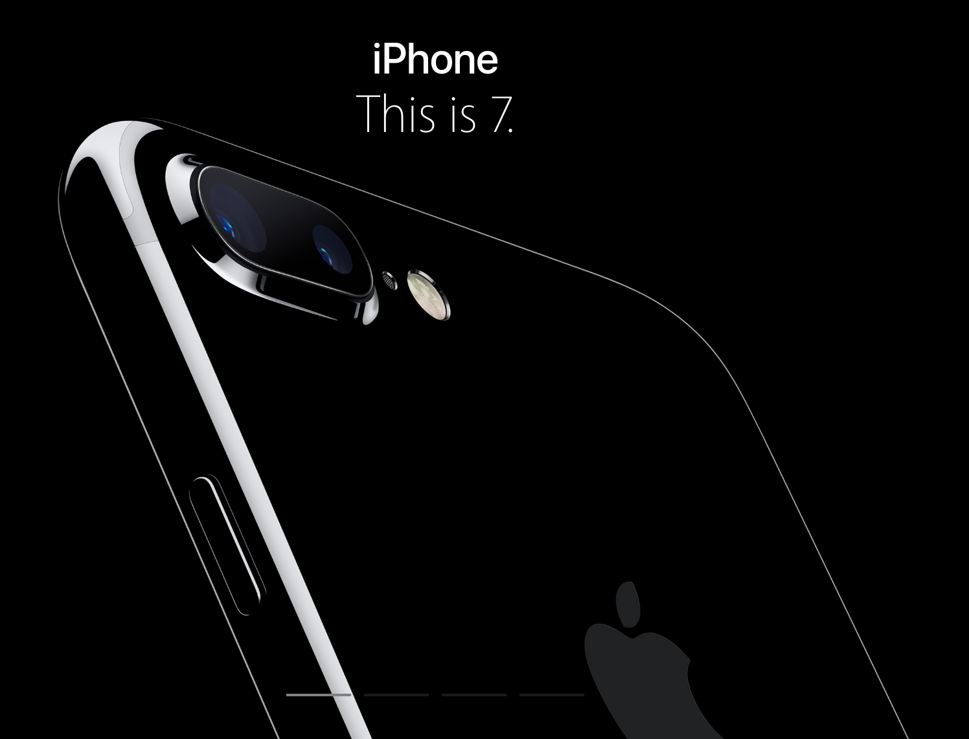
The First thoughts WHEN people received their Iphone7
Study Case 1 @ DS501 Fall2016
Hang Ding
Fangling Zhang
Qingquan Zhao
Yihao Zhou
Tongge Zhu

Slide 2
Who we are?
Hang Ding Statistic (2016)
Fangling Zhang Data Science (2016)
Qingquan Zhao Computer Science (2016)
Yihao Zhou Computer Science (2015)
Tongge Zhu Computer Science (2016)

Slide 3
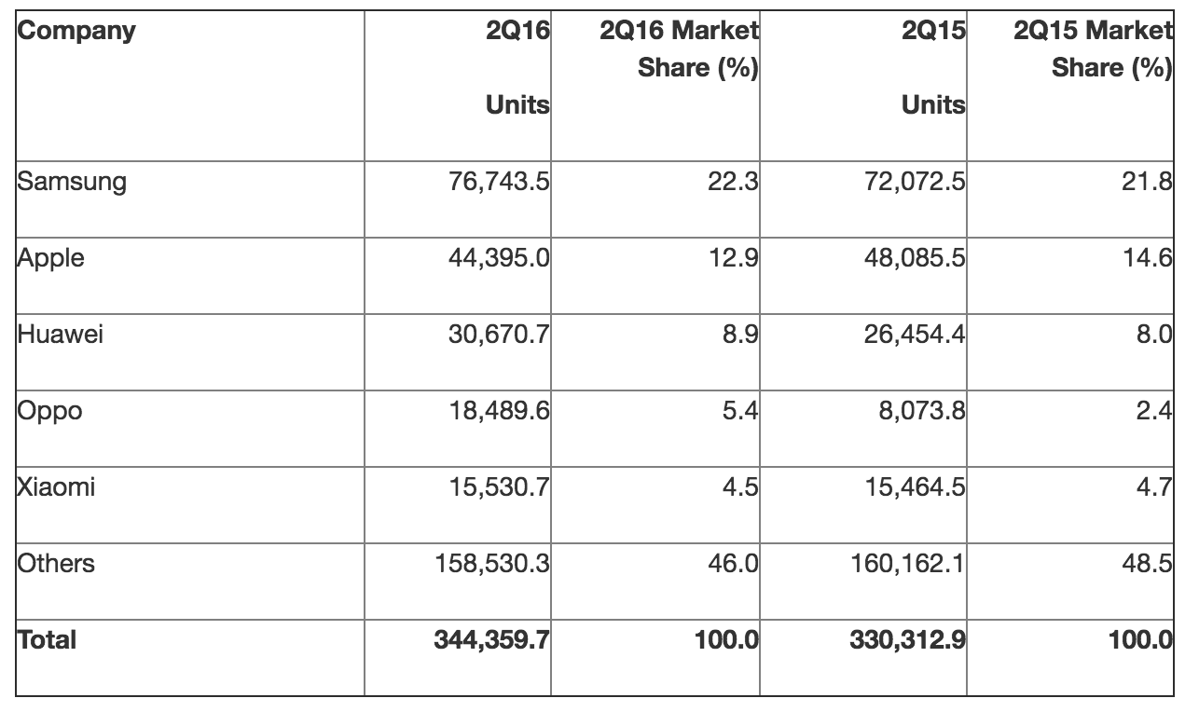
Why Iphone7/7PLUS？
One of the Top Selling Cell Phones
One of the recent hottest topics
New colors
New features
Apple started to sell new iPhone on Sep 16
"Gartner Says Five of Top 10 Worldwide Mobile Phone Vendors Increased Sales in Second Quarter of 2016". Gartner. Retrieved 21 August 2016.

Slide 4
How we collected the data？
From 9:00 to 12:00 Sep 16th
(Streaming, Total: 67436 tweets)
EST 09:00-10:00 24000 tweets
The east coast people in USA start to get new iPhone
EST 10:01-11:00 21135 tweets
EST 1101-12:00 22301 tweets

Slide 5
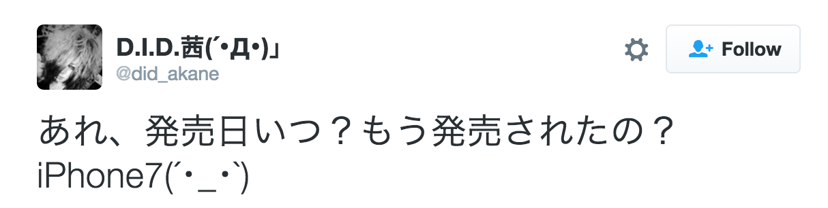
The data Cleaning
Natural Language Toolkit
tweet[“lang”] == “en”
unwanted += [‘https’, ‘http’, ‘...’,’..’,“’’”]
unwanted += list(string.punctuation)
unwanted += list(stopwords.words(‘english’))

Slide 6
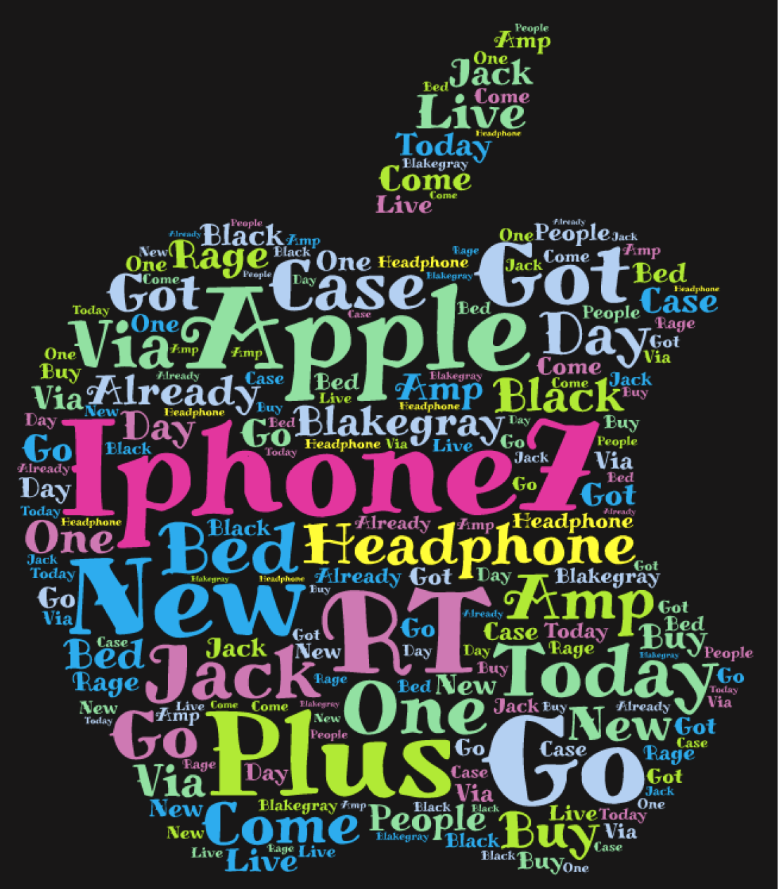
words frequency (top 30)
7 | 22146 | case | 914
RT | 12890 | BlakeGray | 882
Apple | 4431 | already | 878
Plus | 4088 | bed | 875
get | 3320 | I'm | 854
new | 3842 | day | 822
n't | 2325 | via | 813
today | 1298 | buy | 808
got | 1293 | us | 801
go | 1217 | 6s | 777
headphone | 1121 | Black | 776
amp | 1119 | rage | 768
jack | 1089 | people | 736
come | 1080 | live | 730

Slide 7
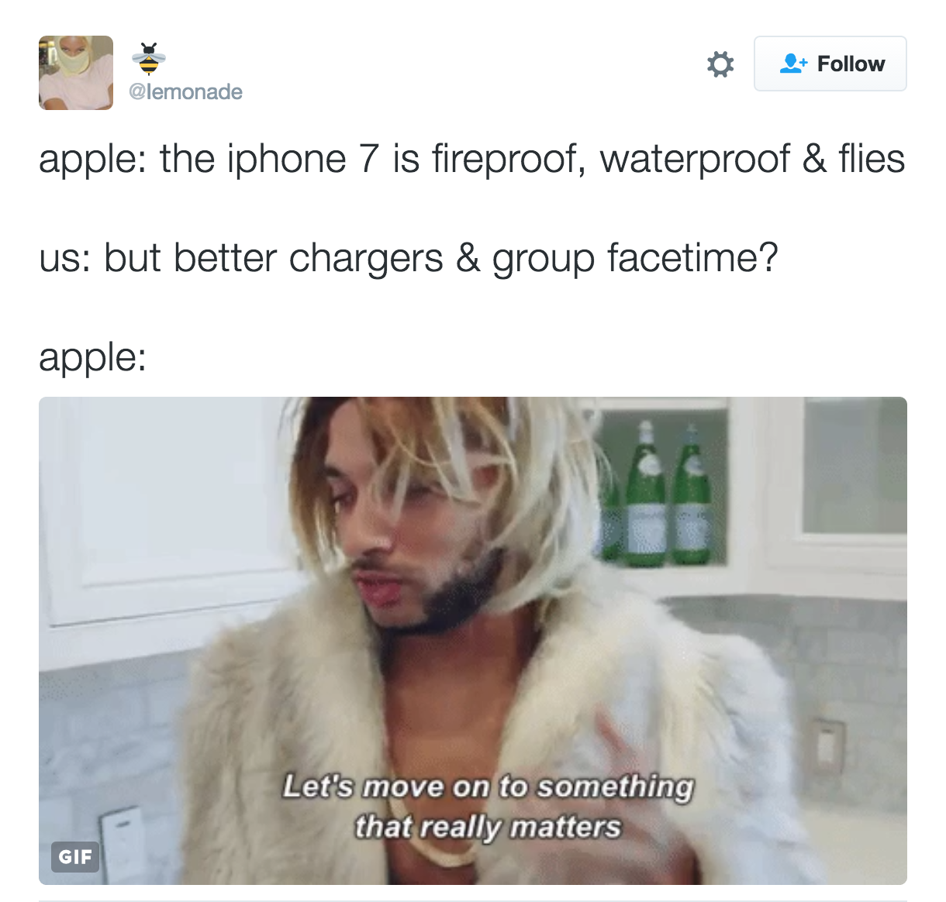
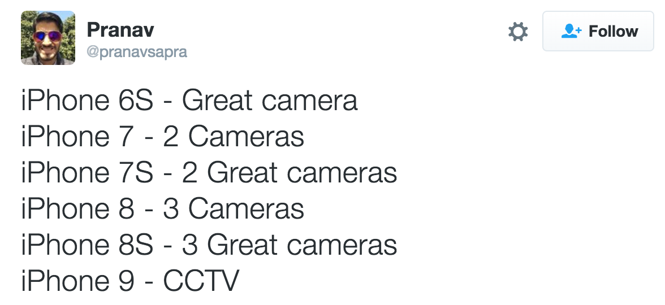
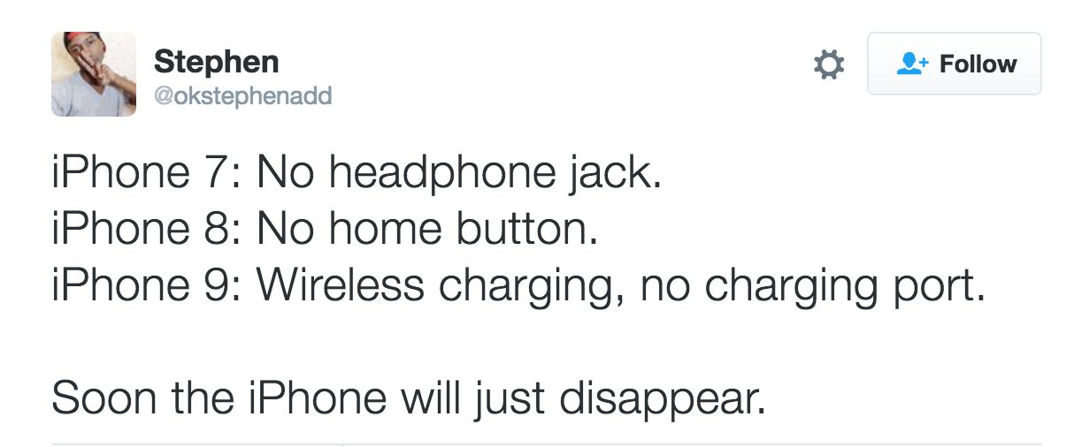
THE Most popular tweets
Retweeted Number
58118
39074
16874
9247
8252
7899
7344
7300
7148

Slide 8
the Most popular Tweet ENTITIES
Top 10 Hashtags | Hashtags
iphone7 | 3655
iphone7TH | 1309
stockmarket | 831
APPLE | 754
invest | 743
Coffee4Hospice | 743
Coffee | 743
chartattack | 743
differentisbetter | 743
Hawkers38HiPhone7 | 341
Top 10 User mentions | User mentions #
imtaiki | 1879
khajochi | 1280
SqeezeReport | 743
YouTube | 406
chaochao_peep | 397
BrianRoemmele | 388
HawkersCo | 289
LUHANLAND | 270
ohmydeer0420 | 249
Apple5x1 | 208

Slide 9
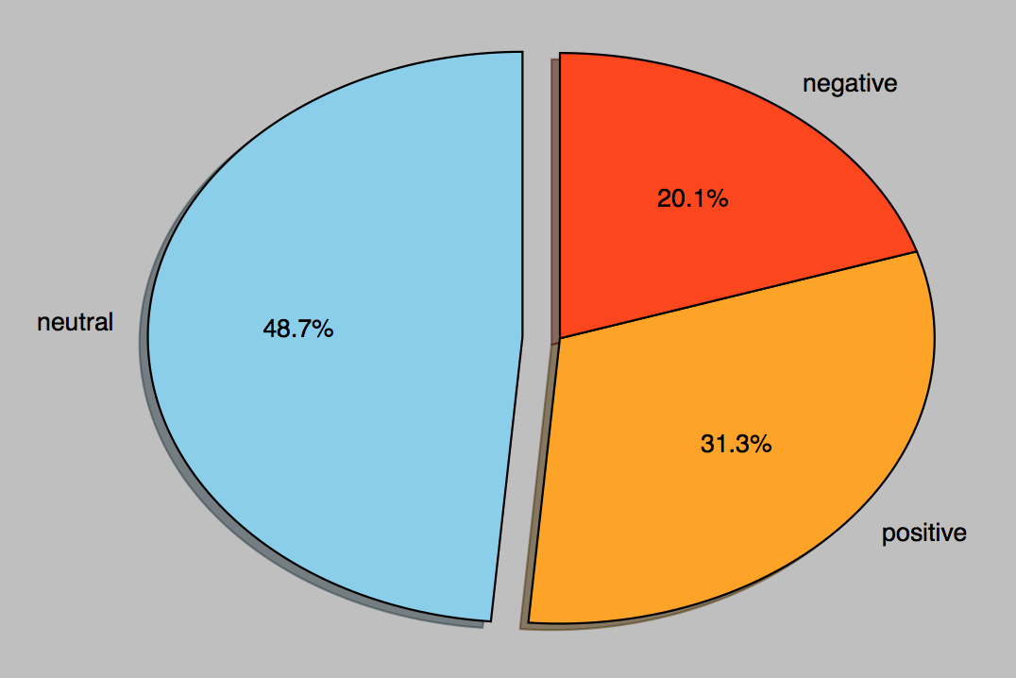
people’s attitudes

Slide 10
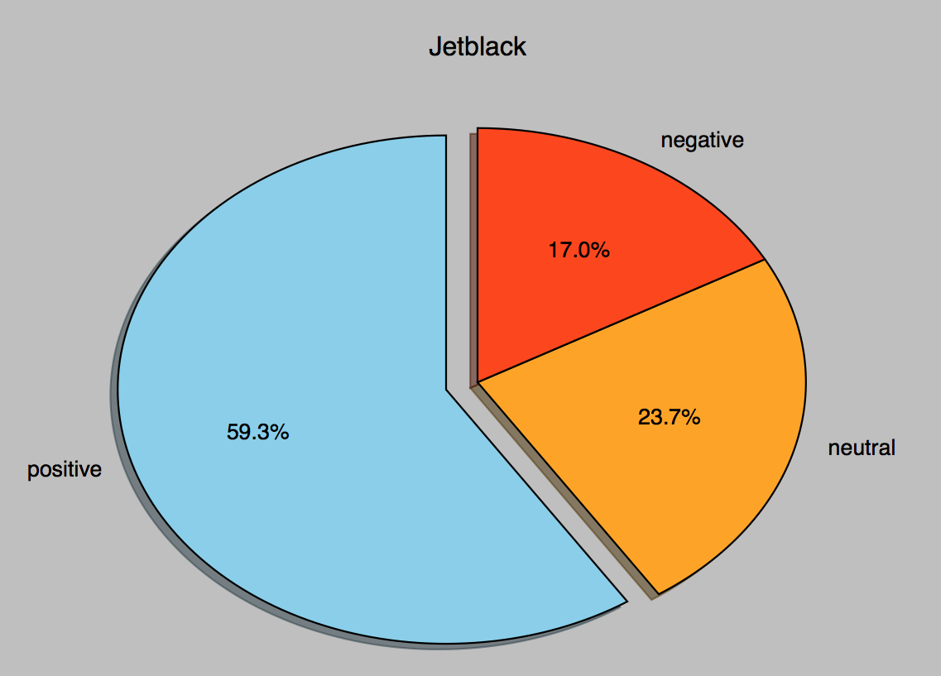

New COLOR: Jetblack

Slide 11
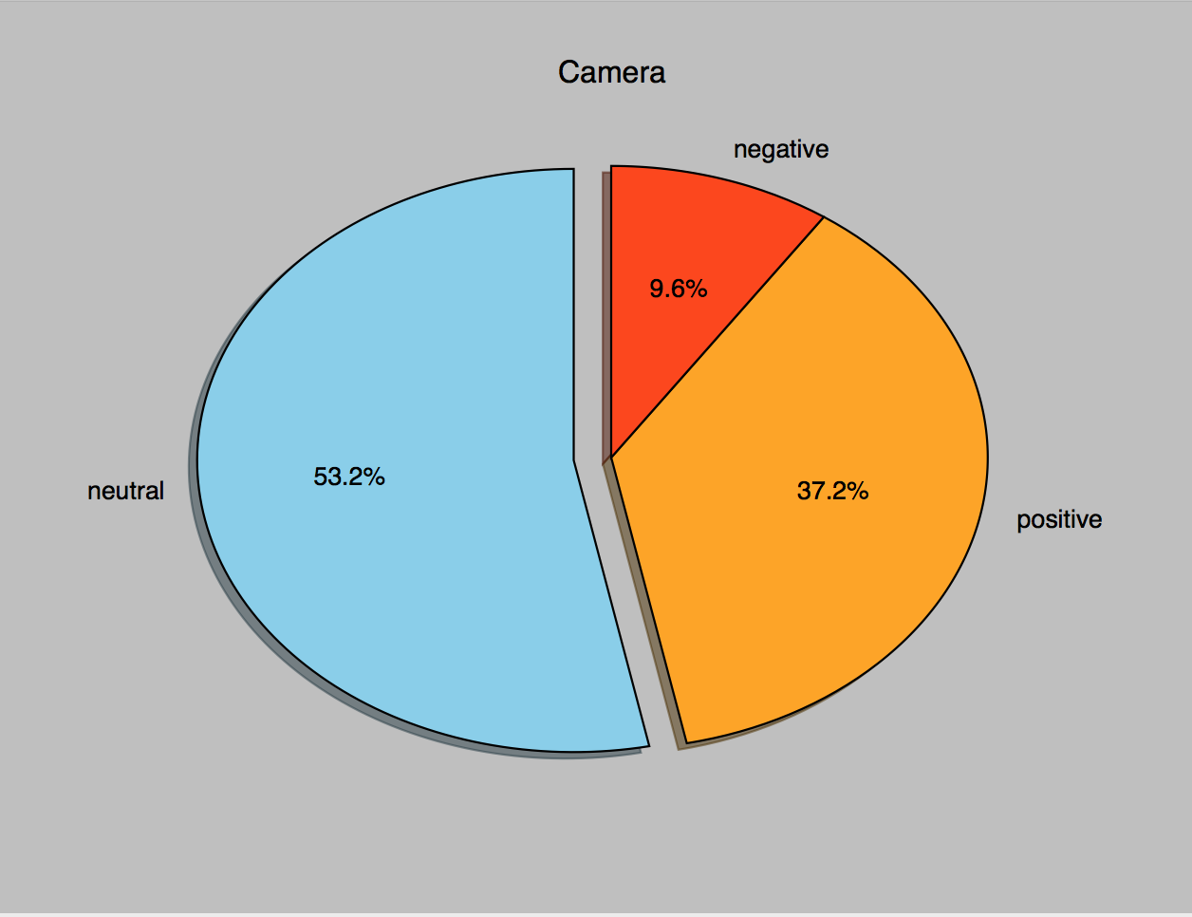
New features: Camera

Slide 12
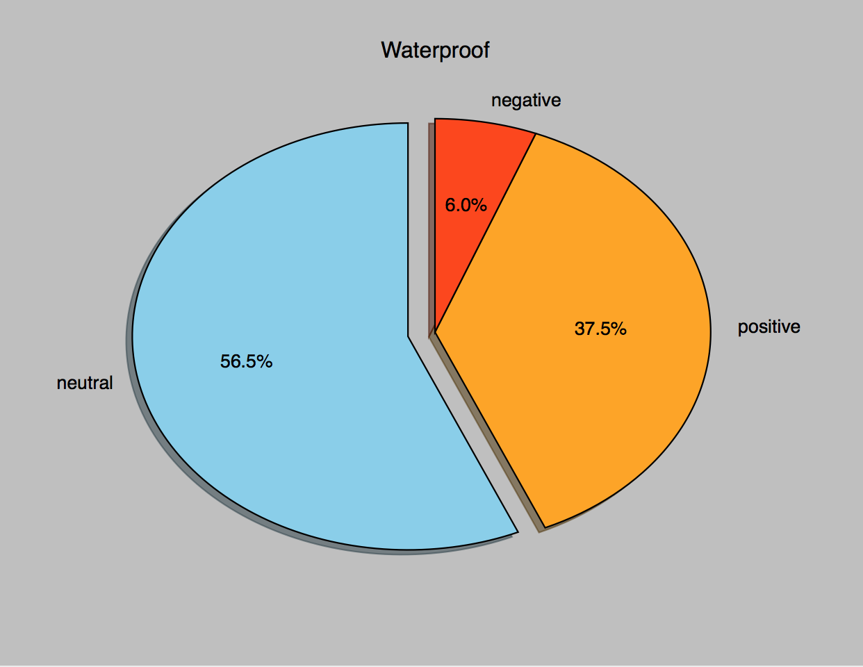
New features：wATERPROOF

Slide 13
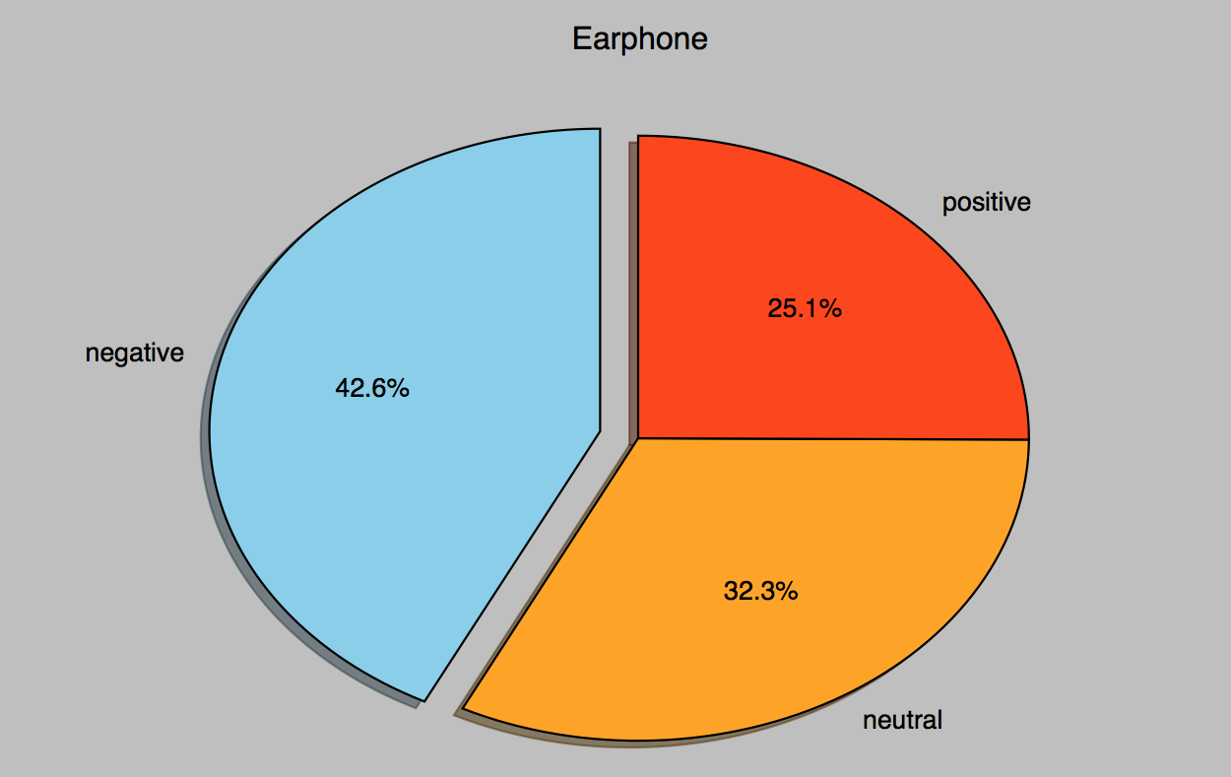

New features: EARPHONE

Slide 14
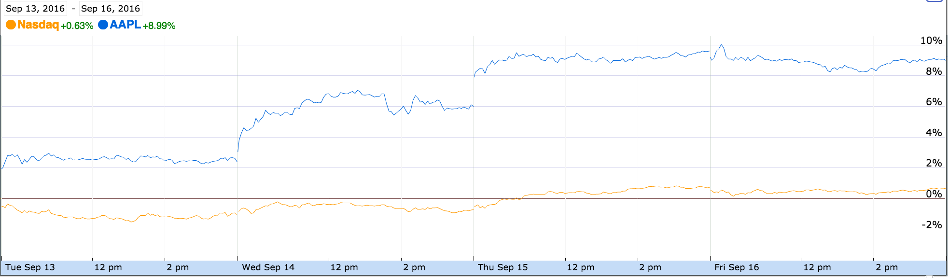
apple Stock on sep 16

Slide 15
Conclusion
We collected 67436 tweets in Sep16 9:00-12:00
We analyzed the data from the following aspects:
Frequency Analysis (Words, Tweets and Tweet Entities)
Analyzed a User’s Friends and Followers (data not shown)
We analyzed people’s attitude towards iPhone and its new features

Slide 16

Thanks for your attention！

Slide 17
Q&A

